Slide 1

TNSDC-GENERATIVE AI FOR ENGINEERING
FINAL PROJECT
Submitted By
Devi Priya E
(311521104010)

Slide 2

PROJECT TITLE
GRAMMAR CORRECTION USING T5 TRANSFORMER

Slide 3

AGENDA
01
02
03
04
05
06
Problem Statement
Project Overview
End Users
Value Prepositions
Solutions
Modelling
07
Results

Slide 4

PROBLEM STATEMENT
This project aims to create an advanced grammar correction system using the T5 Transformer model and the JFLEG dataset. By training the model on annotated data, it learns to automatically detect and fix grammatical errors in text. The system will provide users with a user-friendly interface to input sentences, receive corrected versions, and improve the overall quality of written content.

Slide 5
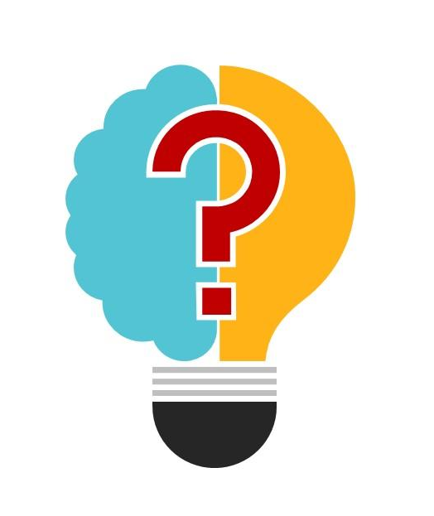
PROJECT OVERVIEW
Grammar correction using T5 transformer project is about creating a smart grammar correction system using advanced technology and real-world data. By training our model with examples of correct and incorrect sentences, it learns to automatically fix mistakes in written text. With a user-friendly interface, people can easily input their sentences and get polished, error-free versions back. Our goal is to help users improve the quality of their writing effortlessly.

Slide 6
END USERS
Writers and Authors: Whether you're drafting articles, essays, or reports, our system ensures your writing is free from grammatical errors, helping you present your ideas clearly and professionally.
Students: Writing assignments, essays, or research papers? Our system provides invaluable support, helping you polish your writing and submit error-free work.

Slide 7
Professionals: From business reports to legal documents, our system ensures your professional communication is impeccable, enhancing your credibility and professionalism.
Non-native English Speakers: Learning English as a second language can be challenging, but our system offers invaluable assistance, helping you improve your writing skills and gain confidence in your English proficiency.
Content Creators: Whether you're a blogger, content creator, or social media influencer, our system helps you maintain high-quality content, engaging your audience effectively with polished and error-free writing.

Slide 8
VALUE PREPOSITIONS
Our code offers a hassle-free solution for training a grammar correction model using cutting-edge technology and the JFLEG dataset. It simplifies the process, allowing users to focus on the task without worrying about complexities. With the accuracy of the T5 Transformer model and the versatility to adapt to different datasets, our code provides value to users of all skill levels. By saving time and effort and delivering accurate results, it empowers users to enhance the quality of written content effortlessly.

Slide 9

SOLUTIONS
Our code utilizes the latest advancements in natural language processing to develop a grammar correction system effortlessly. By leveraging the T5 Transformer model and the JFLEG dataset, it trains a model capable of identifying and correcting grammatical errors in written text. With an intuitive interface and streamlined process, users can quickly input their sentences and receive polished, error-free versions. The system's accuracy and efficiency empower users to enhance the quality of their writing effortlessly, saving time and effort in the proofreading process.

Slide 10
MODELLING
Our model harnesses the power of state-of-the-art natural language processing techniques to refine and enhance written content effortlessly. By integrating the T5 Transformer model with the JFLEG dataset, it becomes adept at identifying and rectifying grammatical errors in text. Through a streamlined process, users can seamlessly input their sentences and receive refined, error-free versions. This intelligent system empowers users to elevate the quality of their writing effortlessly, providing a polished and professional touch with every correction.

Slide 11

RESULTS
Grammar correction using T5 Transformer code effectively trains a grammar correction model using the T5 Transformer architecture on the JFLEG dataset. Through data preparation, model training, evaluation, and inference, it demonstrates the model's capability to identify and rectify grammatical errors in text. These results highlight the potential of the trained model to enhance the quality and clarity of written content, offering a valuable tool for improving communication and readability.

Slide 12
OUTPUT
PROJECT LINK
https://github.com/Devipriyae/GEN-AI.git

Slide 13


